Slide 1
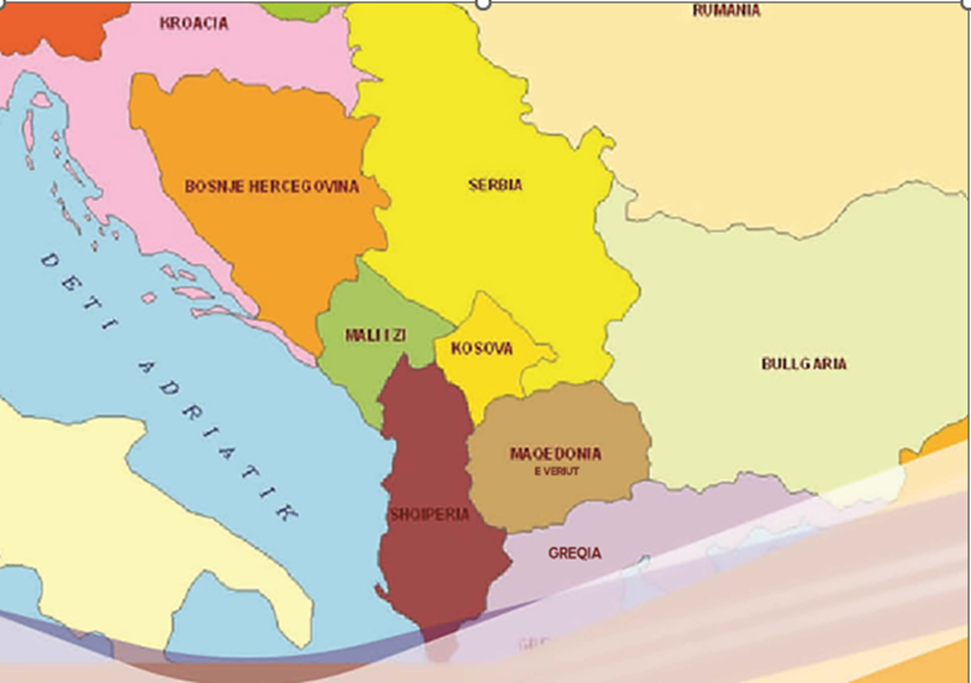
THE SO-CALLED "BALKANISMS" IN THE LANGUAGE AND CULTURE OF THE PEOPLES OF BALKAN
PROF. DR. DHIMITRI BELLO
«FAN S. NOLI» UNIVERSITY OF KORCA

Slide 2
The peoples and languages ​​of the Balkans, despite not having any genetic or familial affinity in their overwhelming part, exhibit a noticeable linguistic and cultural similarity that is perceived as "cultural proximity".
Common features, mainly linguistic, but also more widely, in their customs are conceived as Balkanisms. The linguistic, folklore, and ethnological phenomena, that exist in more than two languages and cultures, are called Balkanisms.
The study of these Balkanisms in specific languages and cultures, in comparison to others, has led to the birth and consolidation of a complex discipline known as Balkan studies.
Commonalities in all linguistic aspects of Balkan people, in their folklore, in their daily life, are the focus of the study of this complex science, but also in its specific parts such as Balkan linguistics, with languages which constitute a linguistic connection, Balkan folklore and ethnology, Balkan ethnography, etc.
Of course, there are many Balkanisms and it is impossible to include and mention them all in a single lecture.
We are primarily focusing on several points that relate to similar phenomena in the field of linguistics, in various aspects such as morpho-syntax, vocabulary including phraseological borrowings, as well as some influences in the field of folklore.

Slide 3
The scope of their study is very wide, but here we will discuss several key points, highlighting them even as phenomena that should be seen and studied even more deeply, in synchrony and diachrony.
We will start with the field of linguistics, which is also basic, focusing on the beginnings of these studies as well as the birth of the relevant term related to Balkan studies.
The distribution of linguistic features according to geographical regions features that transition from one language to another, has drawn the attention of researchers of the linguistic circle of Prague.
However, theoretically and concretely on this issue, the work of Nikolai Sergeevich Trubetzkoy stands out.
This author has presented the idea that exist linguistic connections (German Sprachbund, plural Sprachbünde, in English the linguistic phenomenon is terminologically unstable, it is more often found as a convergence area or linguistic area).
The term "linguistic area" itself was first used by N.T.Turbeckoj in 1923 in Russian- языковой союз and was later translated into German. As a term, Sprachbund was later proposed by Turbeckoj himself at the First Congress of Linguists in Hague in 1928.

Slide 4
Linguistic linkage is characterized by the presence of many common features among languages, which may be a closely or distantly related group but which lie in the geographical neighbourhood.
These common features may not be inherited (distinct languages do not have inherited them from an old ancestor language), but may be from mutual influences between languages and spread geographically.
The common features (of the languages of linguistic linkage) can belong to vocabulary, phonological systems, phraseology, grammar, etc.
They may also pertain to communication features, the development of communication or ending it, different forms of speech (when speaking, when silent, gesticulation, the distance between speakers and who is the "acceptable" and what is considered an "acceptable" distance, eye contact or lack thereof, avoid the eye contact) etc.

Slide 5
Among the linguistic linkages that exist, the Balkan Linguistic one is the most studied. This connection is also the impetus or reason that motivated Turbeckoi to come up with the linguistic term.
These linkages include Albanian, Bulgarian and Romanian as the central language, the northern dialect of Greek and the former Serbo-Croatian as a peripheral language, with its former dialects that today have acquired the status of the standard language.
However, the common features of these languages have been studied even earlier than the term “linguistic linkage” itself.
Balkanisms do not have the same prevalence in the languages of the Balkan Peninsula.
They are more prominent in Albanian, Romanian, Macedonian, Bulgarian and Greek, which are also called Balkan languages. In Serbo-Croatian, Balkanisms are fewer in number and more limited in geographic scope.

Slide 6
GRAMMATICAL STRUCTURE.
In the grammatical structure of the languages that form the Balkan Linguistic linkages, Balkanisms, in the narrow sense of the word, are the most common. We are mentioning some of the main balkanisms by mentioning them as points, with a short argumentation of the phenomenon.
The pre-positioning of the definite article in Albanian, Romanian, Bulgarian and Macedonian. The definite article, in the languages where this phenomenon occurs, is placed in the composition of the word being attached to its end.
Forming the future tense with the help of the verb “dua”/"want" (inflected, respectively uninflected) in Albanian, Greek, Bulgarian, Macedonian, Romanian and Serbian. Here, the auxiliary verb “dua”/"want" loses its semantics, which it has as a separate verb related to desire, passing as an aid to determine the future.
Formal unification of gender and dative cases in Albanian, Romanian and Greek. Here we are talking about languages that have not lost the inflectional system. The genitive and dative forms are the same.

Slide 7
4) Replacement of the past participle by the conjunction in Greek, Bulgarian, Macedonian, Romanian, Albanian and partially in Serbian. Here, what has mostly attracted the attention of scholars is not the shrinkage or loss of the old infinitive, but its replacement almost identical in form, such as the conjunction.
5) Recovery of the objectives through unstressed forms of personal pronouns in Albanian, Romanian, Macedonian, Bulgarian and Greek.
6) Formation of numbers 11-19 with the help of a preposition interposed between the smaller number and ten. The numbers with extensions from 11-19 are structurally similar to 1 plus 10- eleven. This phenomenon is found in Albanian, and Slavic languages ​​of the Balkans, and Romanian.
7) In Balkan languages, there is also a point of convergence, which has been acquired between Albanian, on one side, and Bulgarian and Macedonian, on the other, in their verbal system during their historical evolution. It refers to the forms of the admirative mood in Albanian and those of the retelling mode in the aforementioned Slavic languages.
8) Another phenomenon of Balkan languages, encountered also outside the Balkans, is the use of the verb "to have" in the third person singular as an impersonal verb meaning 'to be located, to exist'.

Slide 8
PHONETIC SYSTEM
Balkanisms, though fewer in number, are also present in the phonetic system.
Regarding the phonetic system, it has generally been asserted that phonetic commonalities among Balkan languages are limited here. Of course, there have been differing opinions as well.
Georgiev (1977) claims that the articulation base in these languages "is similar or nearly the same; a Bulgarian, for example, easily learns Romanian, Albanian, or Greek and speaks them almost “without a foreign accent’.»
Balkan languages have fundamentally identical vowel systems, characterized by dynamic accent, with a lack of phonological quantity and phonological nasalisation. Among the most typical features we can mention here is the presence of the vowel ë.

Slide 9
THE LEXICAL DOMAIN.
Balkan common phenomena are also encountered in the lexical domain.
The lexicon of Balkan languages ​​contains a sufficiently large corpus of identical lexemes, which have been created as a result of the cultural symbiosis of ethnic groups that have populated the Balkan Peninsula.
Although these words (Greek, Turkish, Balkan Latin, Slavic, or substratum) are different in origin, they have been accepted in linguistics as Balkan-wide vocabulary.
Special attention, given by Sandfeld to the detailed study of lexical borrowings from one Balkan language to another, can be called linguistic clarification; the precise determination of the foreign element gives us evidence of the character and degree of relationships between Balkan languages, especially because the theory of linguistic contacts was not developed.
Determining the inheritance and origin of Balkan lexical words in general does not present any major difficulties when it comes to a well-known and well-studied language, although in special cases we may encounter contradictory explanations.

Slide 10
Pre-Slavic borrowings like balta, and gard some Romanian linguists define them as substrate. Major difficulties arise in determining and dividing interbalkan borrowed elements from Proto-Bulgarian and Pecheneg-Kumanian like cung (kërcu), which has Turkish origin.
Determining the interbalkan lexicon with a substrate origin (or the Balkan lexicon in its narrow sense) is a delicate task of Indo-European and Balkan linguistics, especially given the incomplete data of autochthonous languages.
Words with a Balkan (or Balkan-spread) extension, to which the substrate origin is attributed, such as Albanian kopil, Bulg. Копиле with the same meaning as 'illegitimate child', Greek. κοπελλα 'servant boy', Romanian copil 'child', Aromanian. copil, copelă 'illegitimate child', according to the Bulgarian etymological dictionary, is from the Thracian-Illyrian origin.

Slide 11
The commonalities in material and spiritual life, the closeness in the system of moral values and the popular psychology of the peoples of Balkan, all that Sandfeld calls the "same spirit" have found a pure reflection in addition to folklore and phraseology.
The corpus of common phraseology is so large that it would not be excessive to think that special ones in this field are a rarity.
However, just like folklore, this field has not been deeply studied. But a large flow of a fund of 451 Balkan phraseology (and in this number, we have many semantic combinations) which Papahaxhi presents to us at the beginning of the past century (1908).
Sandfeld would add some phraseological units, but without linguistic analysis, which we also find in Papahaxhi.
" The Balkan Phraseological Dictionary" under the leadership of the well-known Albanian lexicologist Prof. Jani Thomaj, provides us with the parallels of the phraseological units of the Balkan languages Albanian, Bulgarian, Greek, Romanian and Serbo-Croatian.
The principles for the drafting of this dictionary are synthesized in the hard work in the field of Albanian phraseology of Jani Thomaj, which must be analyzed in the context of Balkan phraseology and thus provides a model for the study of phraseology in other languages of Balkan, which generally do not move from the frames of the respective language.

Slide 12
For Albanian phraseology, equivalents in other Balkan languages are provided, where complete parallel phraseological idioms with identical structures (calque type) are more numerous; the following are equal in the semantic-functional direction, but with different thematic phrases; further, semantic-functional figurative expressions that do not even reach the status of a phrase; and finally - the same semantic periphrases.
One of the most widespread and characteristic features in the Balkan languages are verbal connections, in which verbs are primary and most common, while nouns denote parts of the body or something of daily use.
Albanian: vë dorën; ngriti krye; shtriu dorën; na hëngri veshët
Bulgarian: слагам рака; दिगाम ग्लावा; протягам рака; изяде ми уровье
Greek: βαξω χερι; σεκφωνω κεφαλι; απολοσε το ηερι μου; εραγε τ’αφτια
Romanian: work mînă; raise the head; aîntinde mîna; ni amîncat urechile.
A significant part of balkaisms can also be found in the folklore of the peoples of the Balkans. Perhaps here we should add, especially for young researchers dealing with Balkan studies, that the approach studies in Balkan folklore are not exhaustive, so there are still parts that are not illuminated and not treated properly.
And here we are talking about oral traditions, fairy tales, stories, folk songs, proverbs, dance, music and musical instruments, etc.

Slide 13
Here we are stopping at only 2-3 moments because the common material is very large.
We are starting with what in comparative folklore is known as "Leonora's motif", but in the Balkan, where the subject is also different, it is known as "Ballad of the dead brother".
It involves the resurrection of the dead brother from the grave to retrieve his sister, to keep or "besa" as it is known in Albanian, and and to bring her back to their mother.
This song has had a great spread among the people of Balkan. The spread of this song has been carefully studied by the Bulgarian scholar I. Shishmanov, but a better understanding of it is provided by the Albanian researcher Fatos Arapi.
Here we have the opportunity to see two different typologies related to this song.
Another popular legend in the Balkan and beyond of it is the song that talks about walling up a living woman on the leg of a bridge or a castle, to fortify the structure.
This song, depending on the geographical location of the event, is attributed to a castle in Shkodra, in Porto Palermo, a bridge in Dibra, in Berat, in other places in the Balkans such as Serbia or Bosnia, Greece, Romania, etc.

Slide 14
THANK YOU !

